Slide 1
Code Visualization

Slide 2
Good Design
Naming | Complexity
Cohesion | Coupling
Notes:
Aspect Guideline Metric Visibility
Naming Names should reflect problem domain None High
Complexity Methods should have a low cyclomatic <10 High
Cohesion Modules should be small and follow the <1KLOC High
single responsibility principle
Coupling Low coupling and dependencies towards None Low
abstractions and interfaces. No cycles.

Slide 3
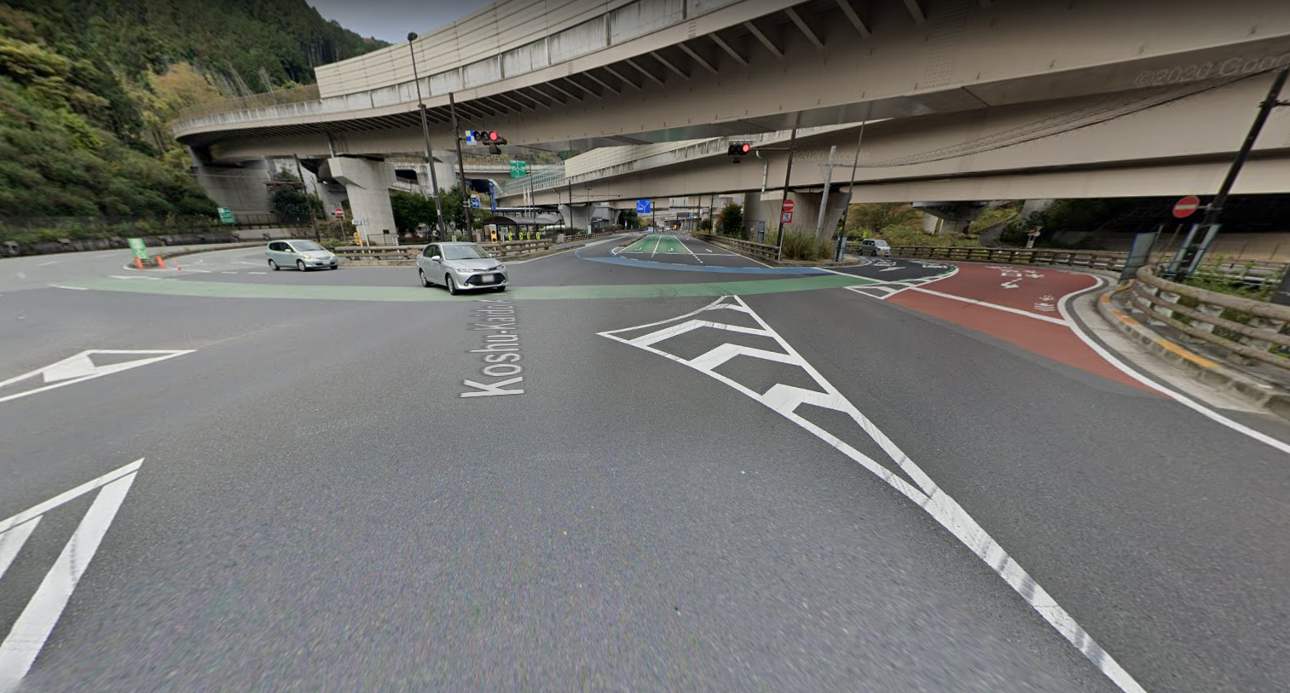
Takaosan Interchange, Hachioji, Japan

Slide 4
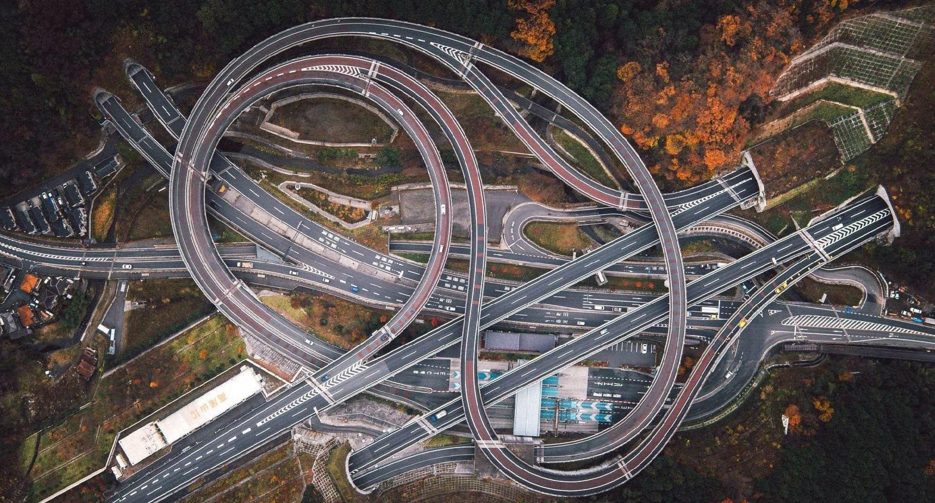

Slide 5


Slide 6

Domian
Prog
Impact

Slide 7

Fact
Reduce defects
Domain knowledge
Programing Languages
Impact Analyses
[Making Software Book, chapter 25]
-

Slide 8

As developer

Slide 9
On Boarding

Slide 10
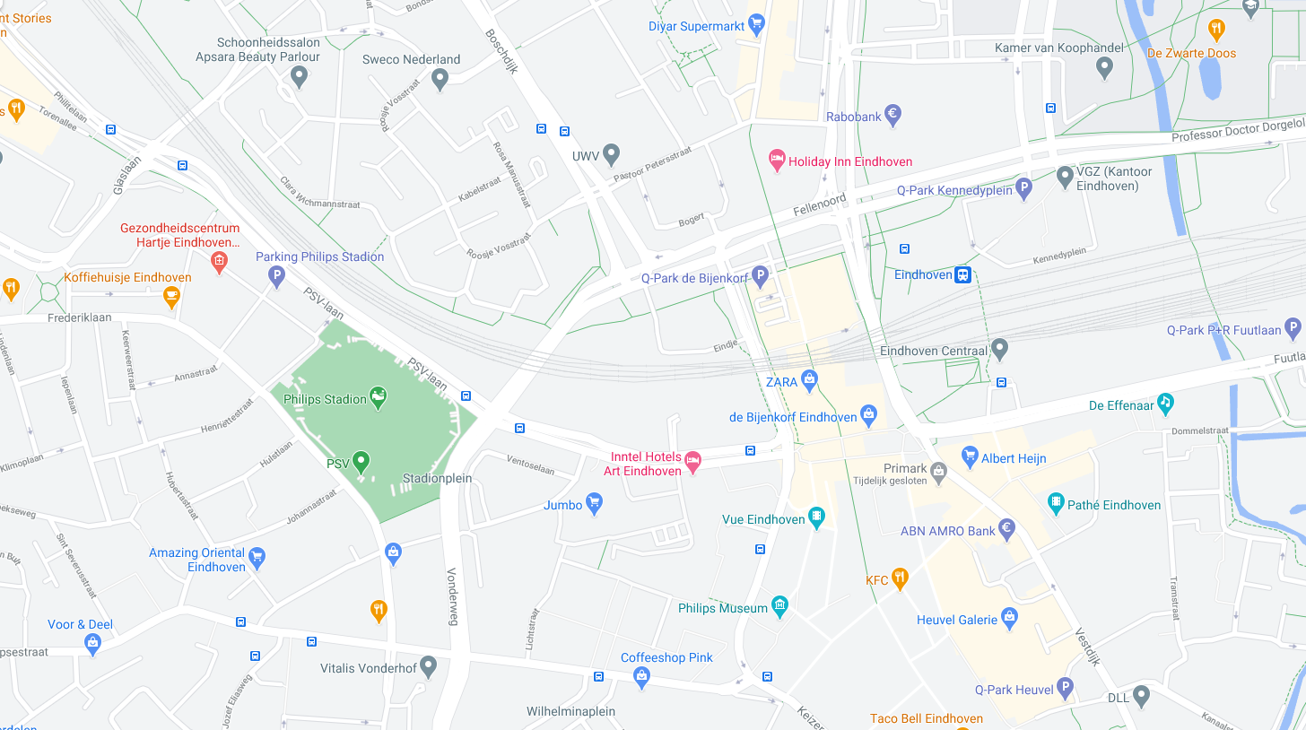

Slide 11
Fix Defect

Slide 12
Fact
The effort to locate a fault reduced by 50% for simple faults, and 20-25% for complex faults
[Accenture and Infosys study]

Slide 13
Refactor Code

Slide 18
Fact
Developers spend up to 50 percent of their time searching for information
[Ko et al. 2007; Murphy et al. 2006]

Slide 19
As architect

Slide 20
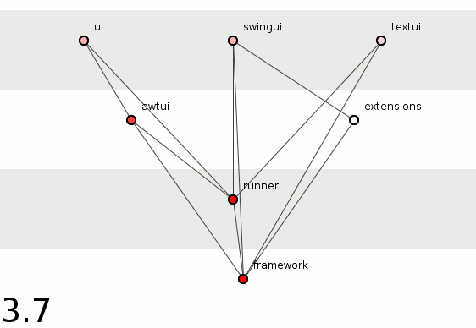

Slide 21
Software Rot
Rigidity
Fragility
Immobility
Viscosity

Slide 22
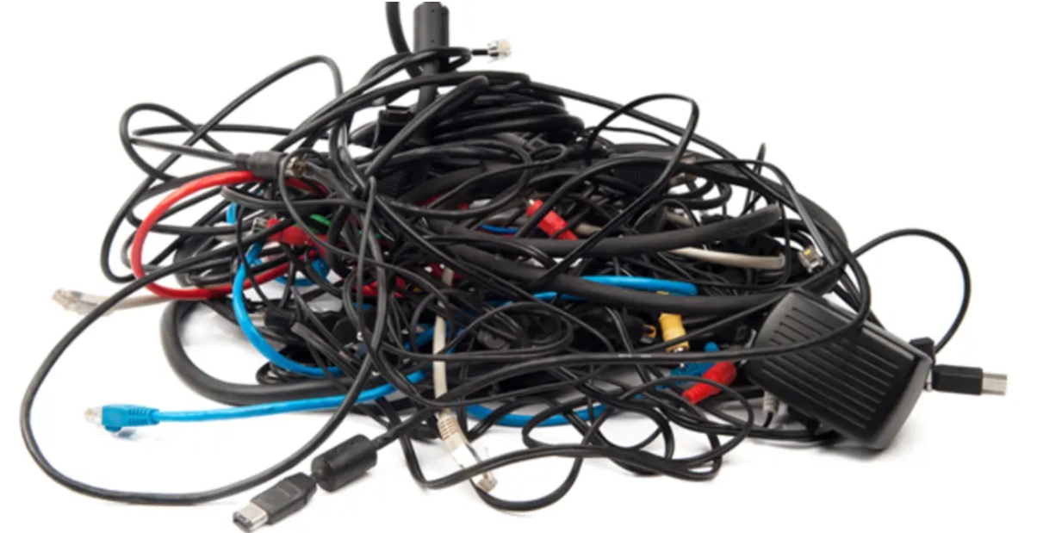

Slide 23
Fact
Lower productivity 50% decline for complex code
[Cost of Complexity – Dan Sturtevant]

Slide 24

Intentional architecture
Defines a set of purposeful, planned architectural strategies and initiatives, which enhance solution design, performance, and usability and provide guidance for inter-team design and implementation synchronization.

Slide 25
Emergent design
Provides the technical basis for a fully evolutionary and incremental implementation approach. This helps developers and designers respond to immediate user needs, allowing the design to evolve as the system is built and deployed.

Slide 26
Intentional vs Emergent: But how

Slide 27
Task: Improve Build Time

Slide 28
Can not

Slide 29
As tester

Slide 30
Need: Integration Strategy

Slide 31
Fact
Defects increase up to 8.3X
[Cost of Complexity – Dan Sturtevant]
 | Very High | 5.86 | 8.39 | 13.66 | 18.42
 | High | 5.78 | 8.28 | 13.47 | 18.18
 | Mid | 4.49 | 6.44 | 10.47 | 14.13
 | Low | 2.22 | 3.18 | 5.18 | 6.98
 |  | Periph | Utility | Control | Core
McCabe
Classification
Architectural Classification

Slide 32
As manager

Slide 33
Need: Out source
Little deps

Slide 34
Fact
Higher staff turnover - 10x increase in voluntary and involuntary terminations for complex code
[Cost of Complexity – Dan Sturtevant]

Slide 35
Lines and Boxes Visualization

Slide 36

Notes:
UML is best known lines and boxes notation

Slide 37
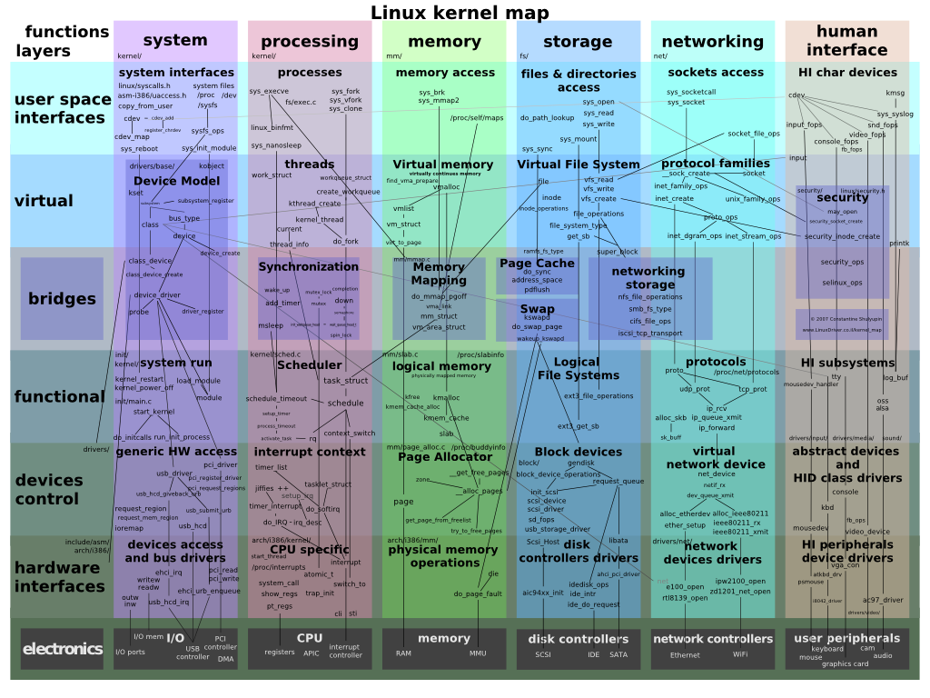
Notes:
But at some point it becomes too cluttered

Slide 38
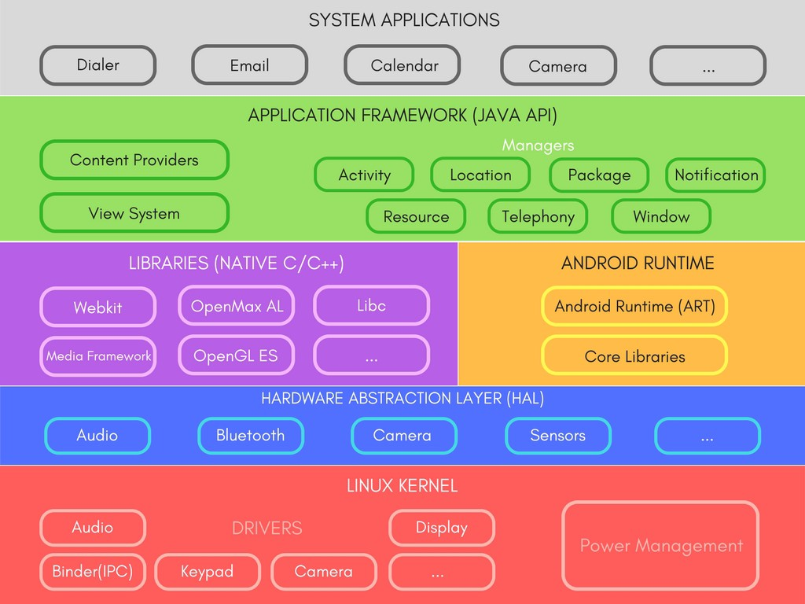
Just Boxes No Lines
Notes:
And then only boxes are shown

Slide 39
“The highest-level breakdown of a system into its parts; the decisions that are hard to change”
[Patterns of Enterprise Application Architecture, Martin Fowler]
“.... software elements, the externally visible properties of those elements, and the relationships among them”
[Software Architecture in Practice (2nd edition), Bass, Clements, and Kazman]

Slide 40
Design Structure Matrix Visualization

Slide 41
Many dependencies
Wrong direction
Skip layer
Cycle
Not used

Slide 42
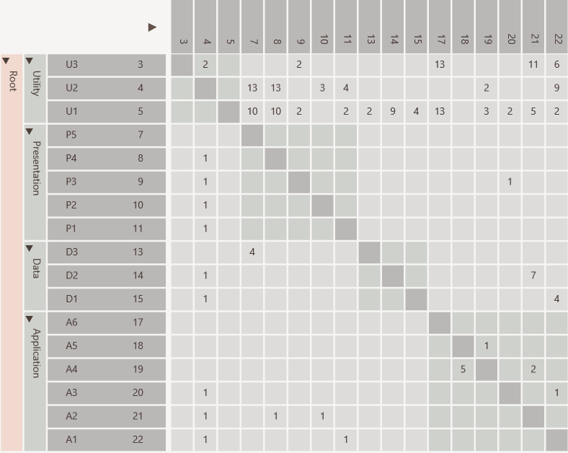
Same rows and columns
Identity line
Value indicates strength
P5 uses D3
Hierarchy

Slide 43
Scalable

Slide 44
Dependencies from A1 to U1, U2 and U3
individually

Slide 45
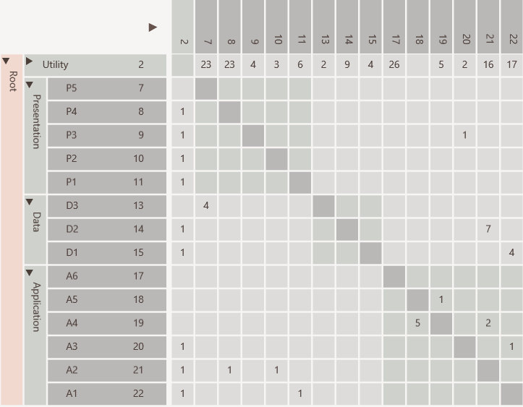
Dependencies from A1 to U1, U2 and U3
aggregated

Slide 46
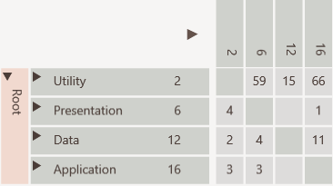
All dependencies between Application and Utility collapsed

Slide 47
Discovery

Slide 48
Many dependencies above identity line

Slide 49
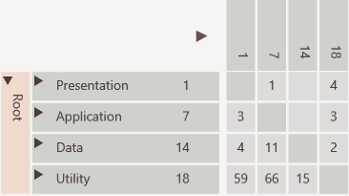
Consumers to top
Cycle easily visible
Providers to bottom

Slide 50
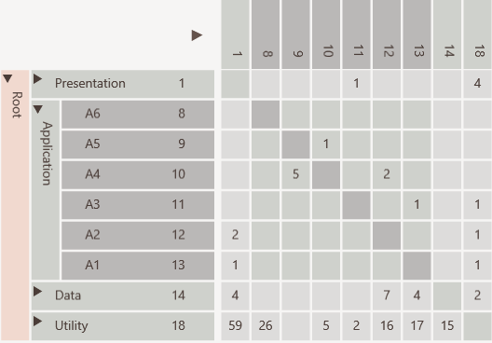
Not used
Encapsulated
Public interface
Encapsulation Pattern

Slide 51
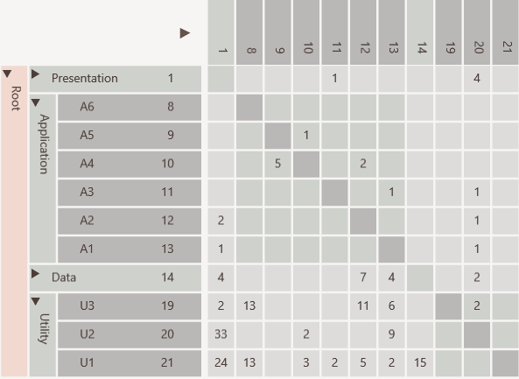
Elements used in entire software like utilities and data access objects
Bus/Utility Pattern

Slide 52
U2 has many in and out going dependencies
Change Propagator Pattern

Slide 53
Refactoring

Slide 54
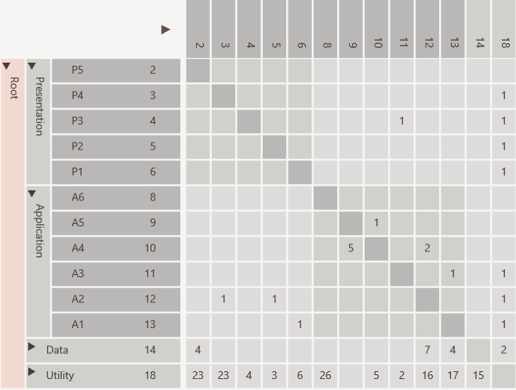
Hierarchical cycle due to
A3 using P3
which violates layering
Before

Slide 55
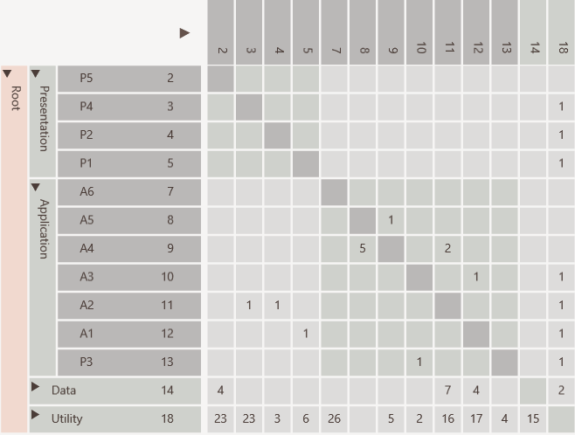
Cycle removed by moving P3
After

Slide 56
DSM book

Slide 57
Treemap Metric Visualization

Slide 58
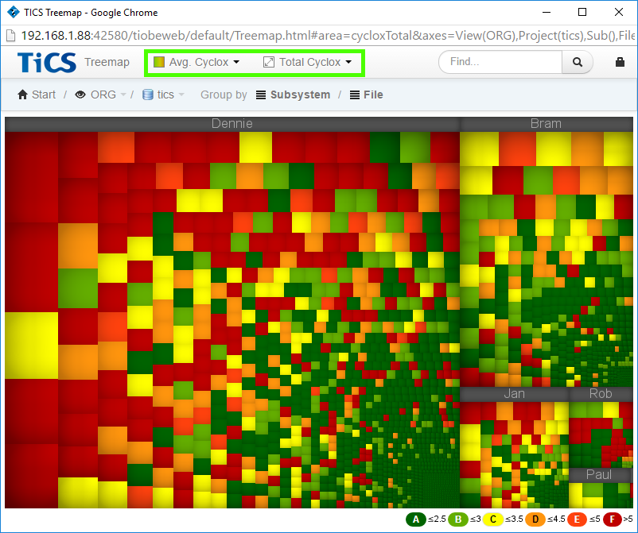

Slide 59
Code City Metrics Visualization

Slide 60
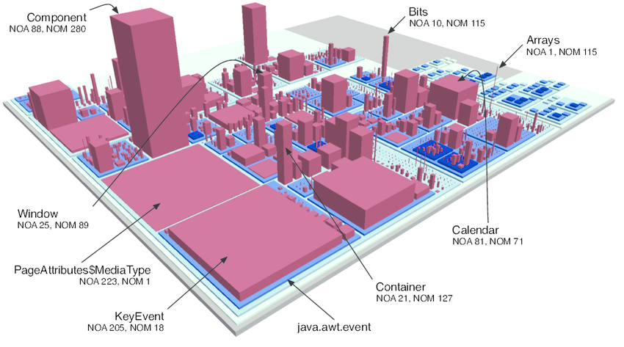

Slide 61
Tools

Slide 62
Programming
Language
Checks
Design
Metrics
Dependency
Visualization

Slide 63
DsmSuite

Slide 64
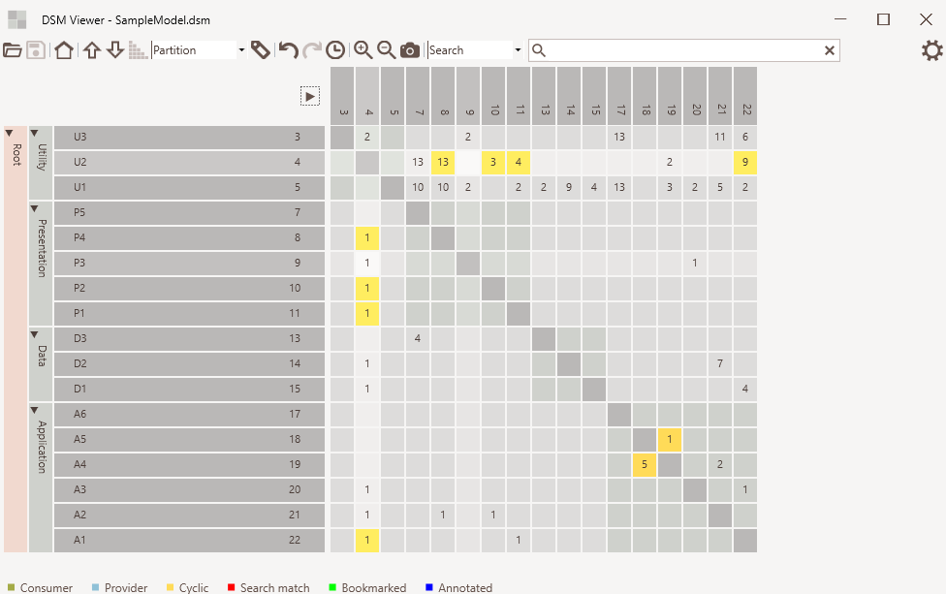
Cell
selected
Element Hierarchy
Cell
hovered

Slide 65
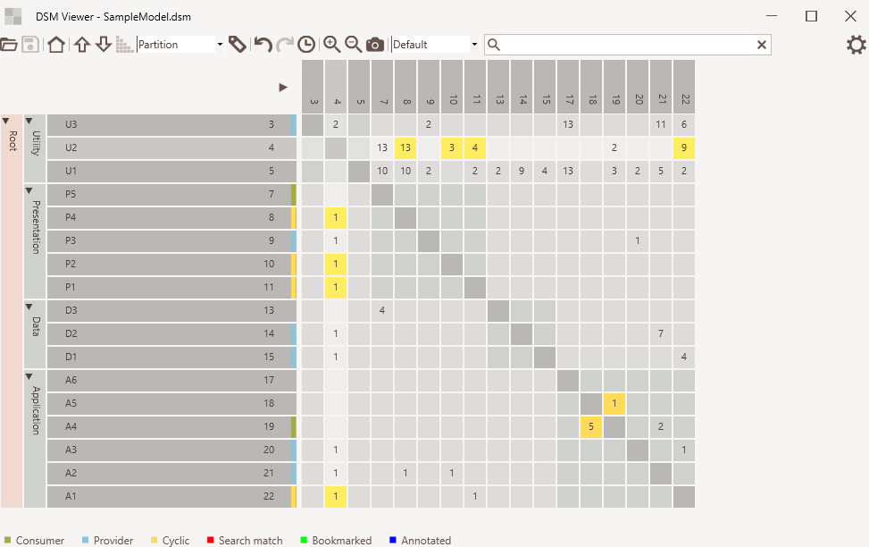
Default mode
Consumer/provider indicators
Normal dependency
Cyclic dependency

Slide 66
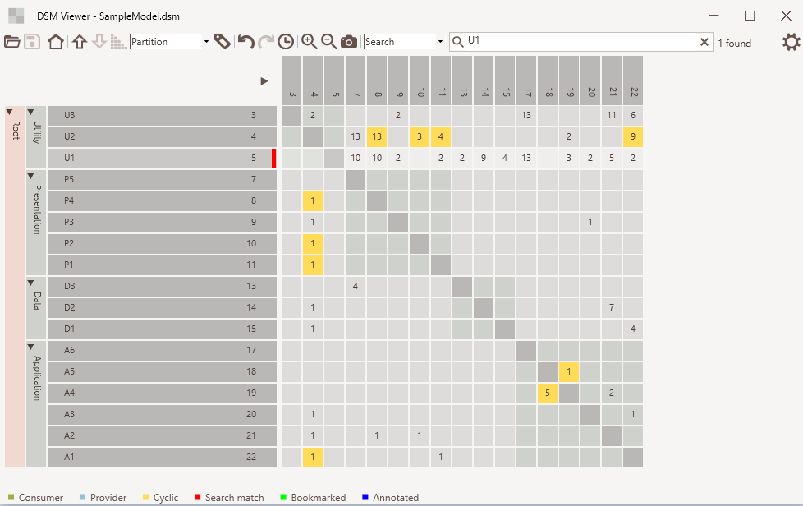
Search mode
Search text
Elements found
Match indicator

Slide 67
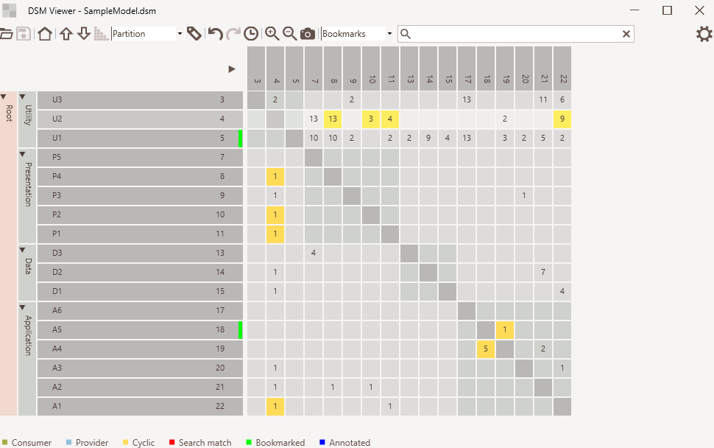
Bookmark mode
Bookmarked
indicator

Slide 68
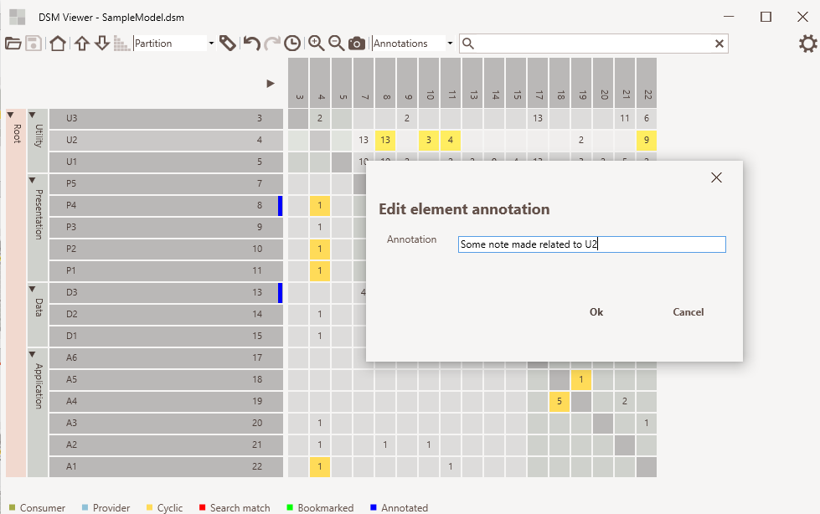
Annotation mode
Annotated
indicator

Slide 69
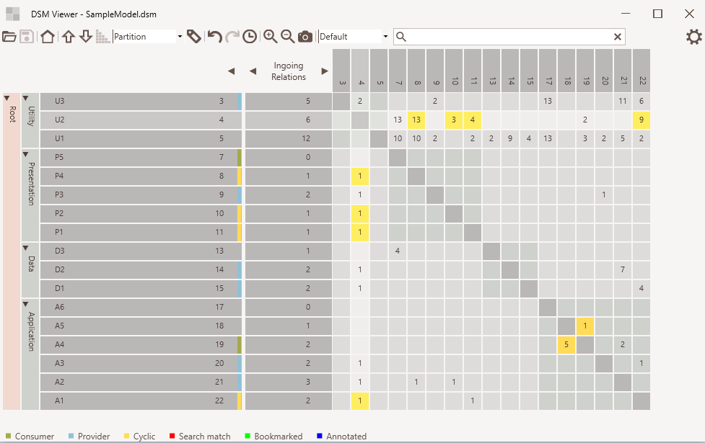
Expand / collapse
Metrics selection
Metrics values

Slide 70
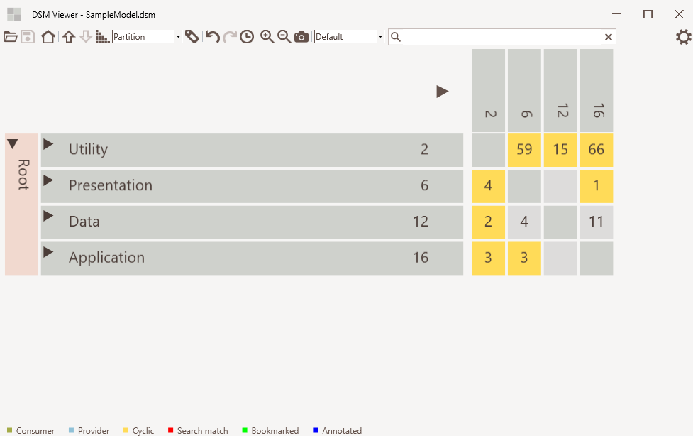
Zoom in/out
Screenshot

Slide 71
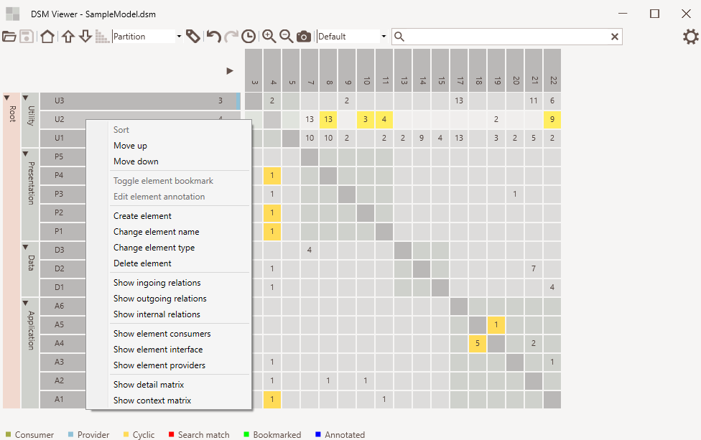
Element context menu

Slide 72
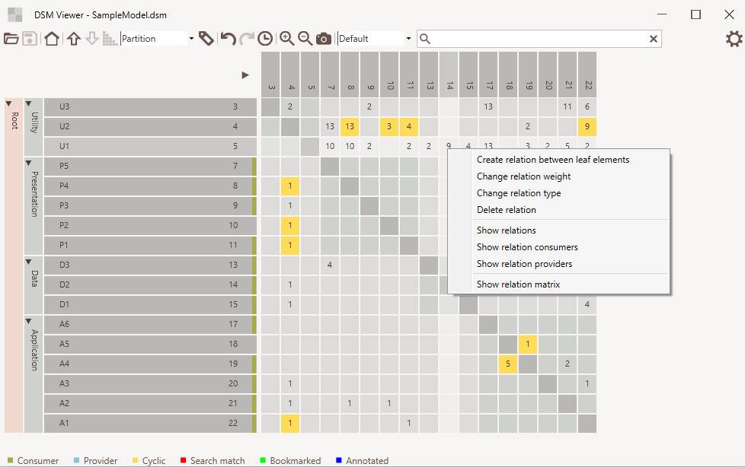
Relation context menu

Slide 73
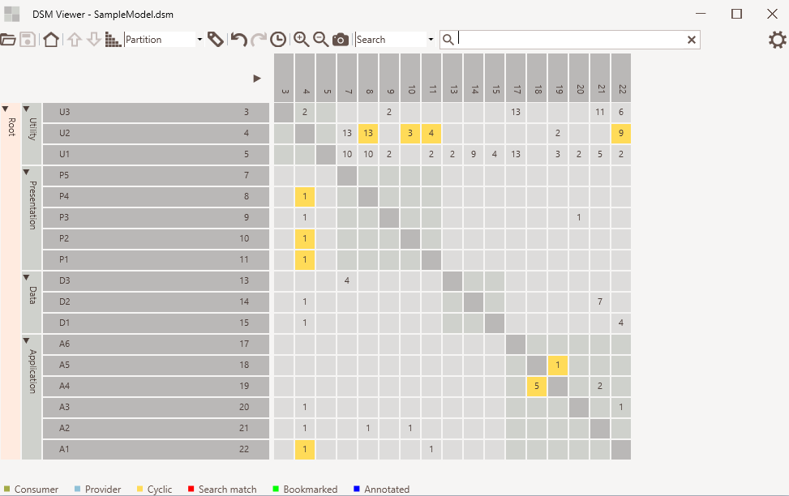
Move up/down
Sort
Undo/redo and history
Move element using drag and drop
Edit relation using cell context menu
Edit element using cell context menu

Slide 74


Slide 75
Lattix

Slide 77
Enterprise Architect

Slide 79
NDepend

Slide 81
Understand

Slide 83
Structure101

Slide 85
Analyze DsmSuite

Slide 86
Comparer
Analyzer
Compares
Analyzer
Analyzer
Analyzer
DSI
file
Viewer
DSM
file
Analyzer
Exports
Imports
Visualizes
.Net, Java, C++, Visual Studio and UML
Conforms To
dsi.xsd
Third Party Analyzer

Slide 87
DsmSuite

Slide 88
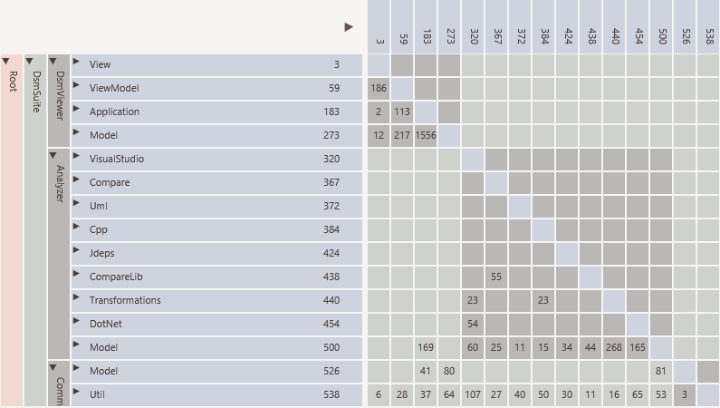

Slide 89
Enterprise Architect

Slide 90
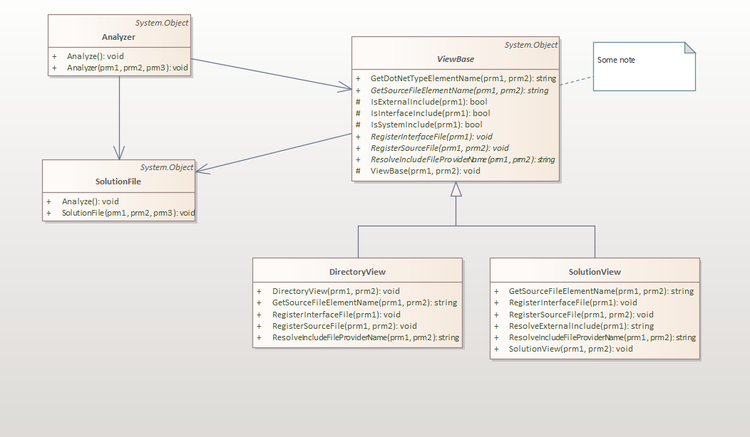

Slide 91
NDepend

Slide 92
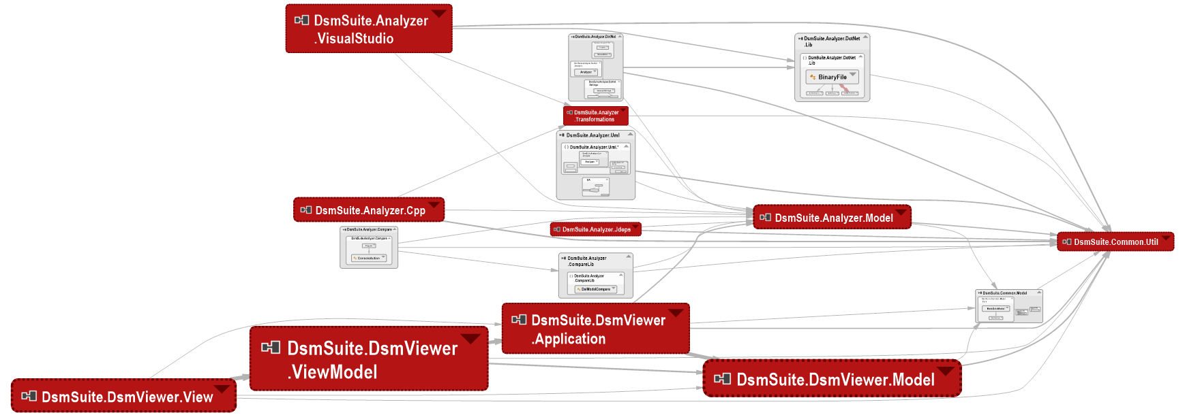

Slide 93
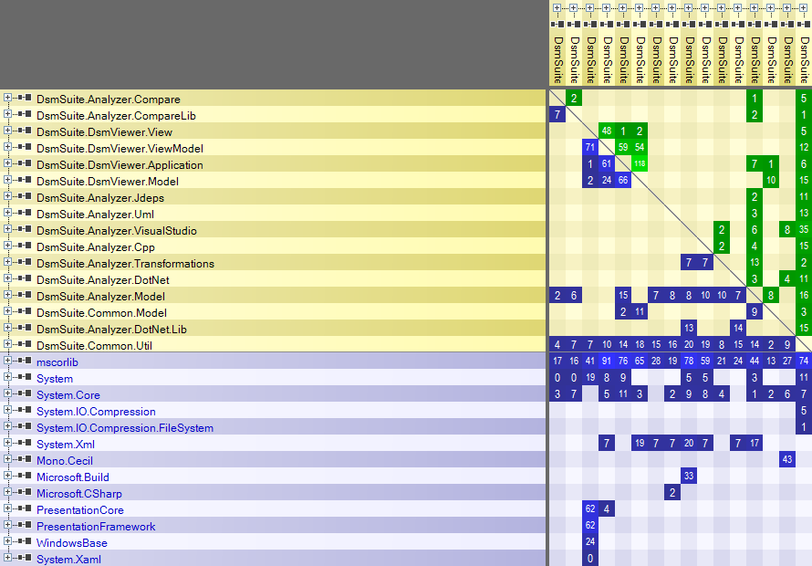

Slide 94
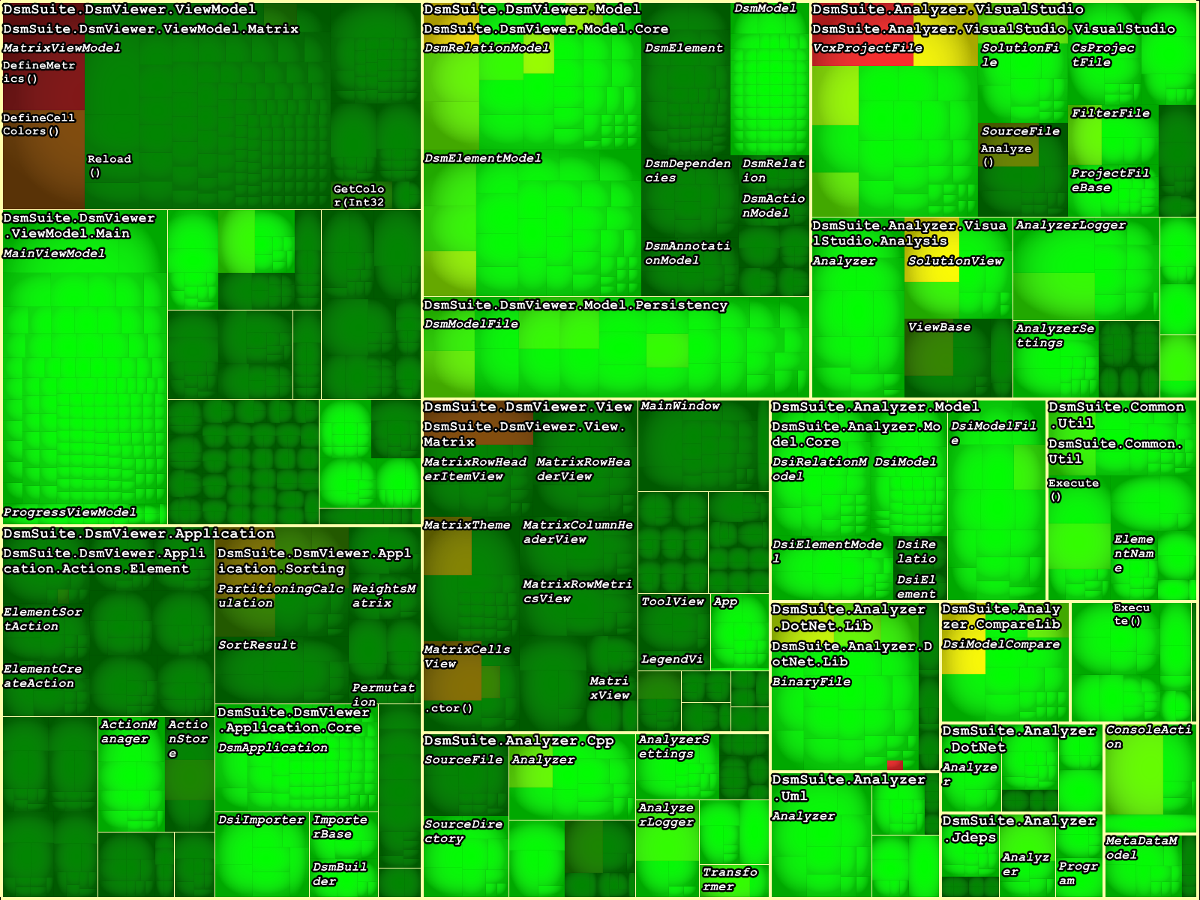

Slide 95
Analyses ArgoUml

Slide 96
DsmSuite

Slide 97
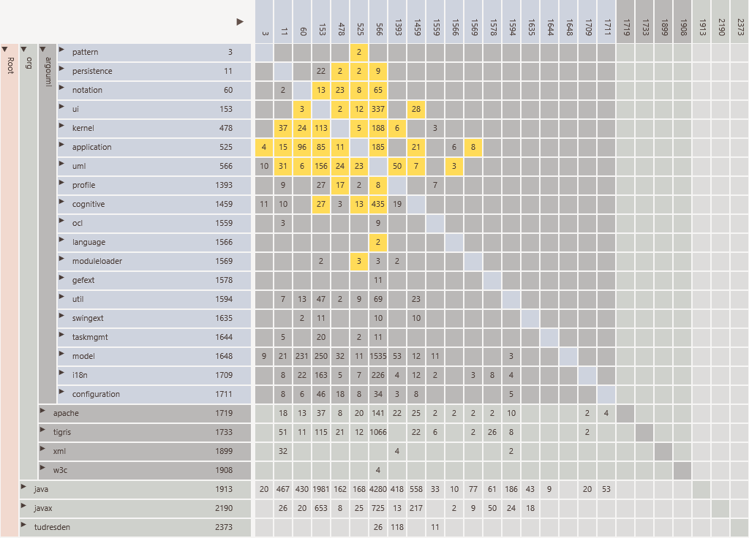

Slide 98
Structure101

Slide 99
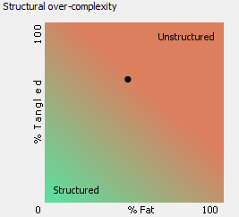
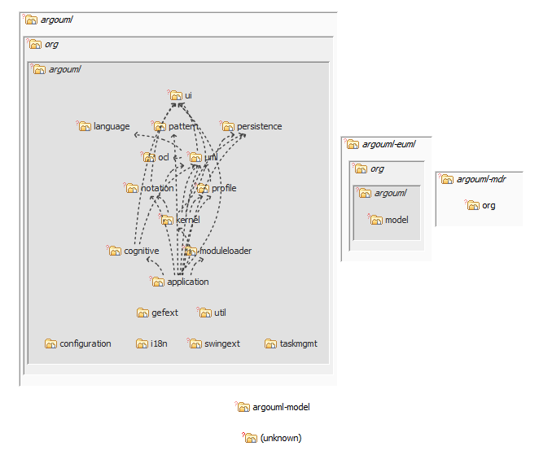

Slide 100
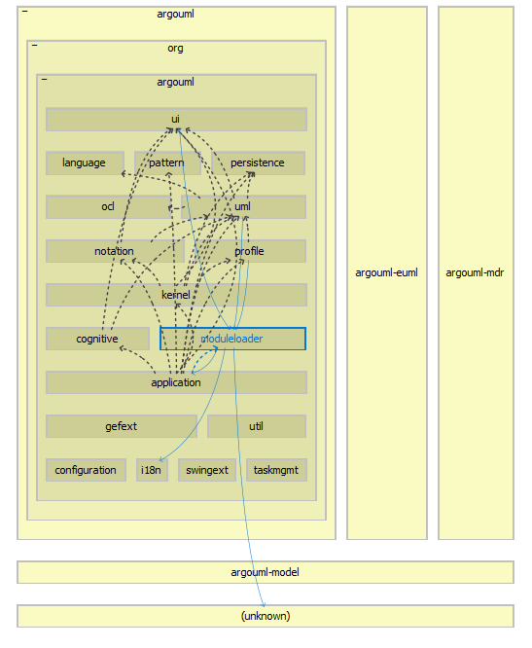

Slide 101
Analysis Telegram

Slide 102
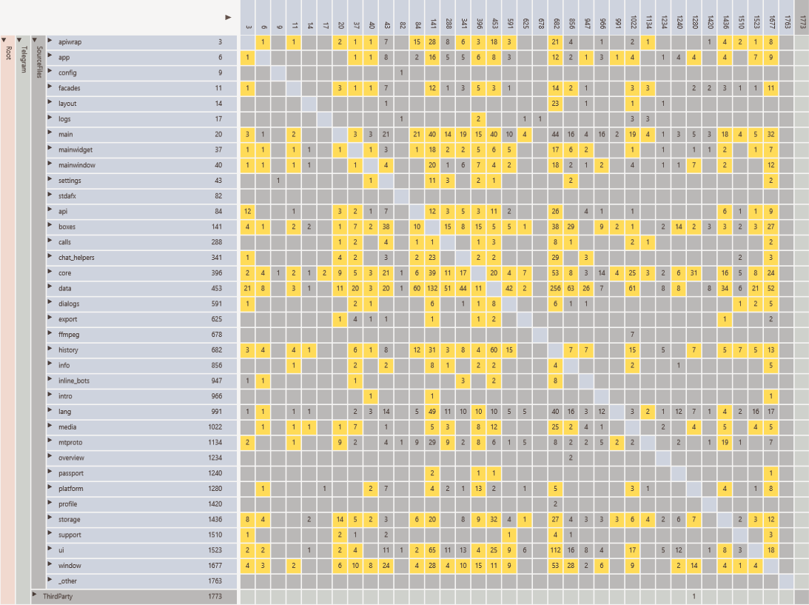

Slide 103
Sorted

Slide 104
Analysis Poco

Slide 105
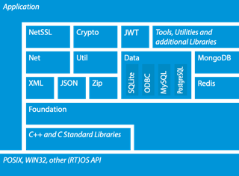
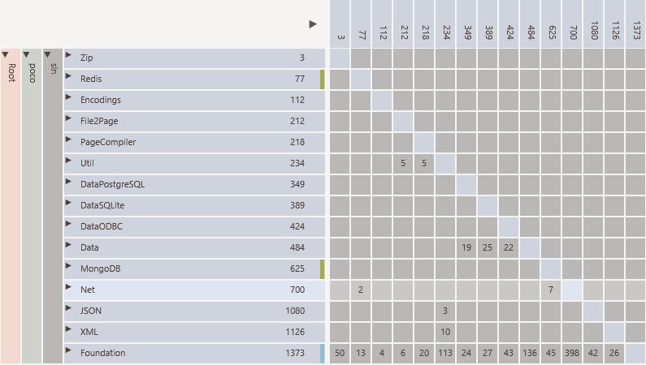

Slide 106
Analysis Qt

Slide 107
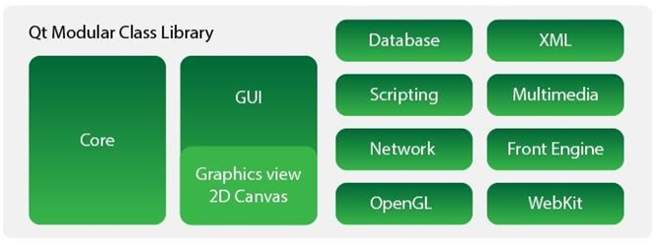
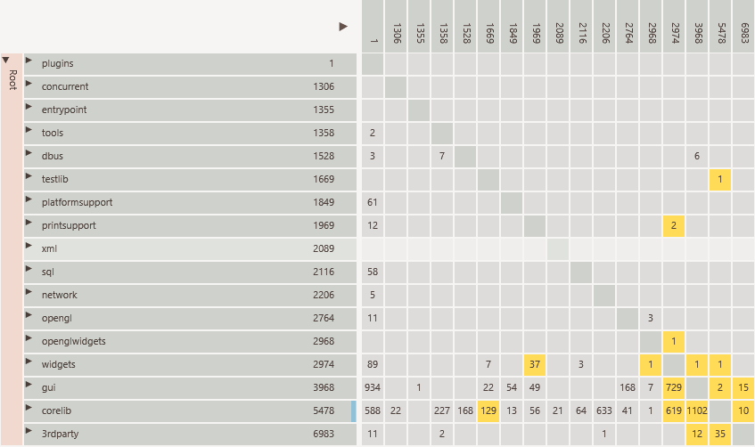

Slide 108
Analysis Linux

Slide 109
DsmSuite

Slide 110
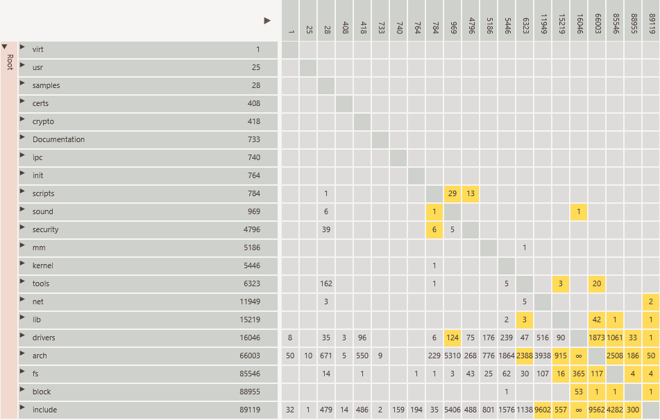

Slide 111
Understand

Slide 112
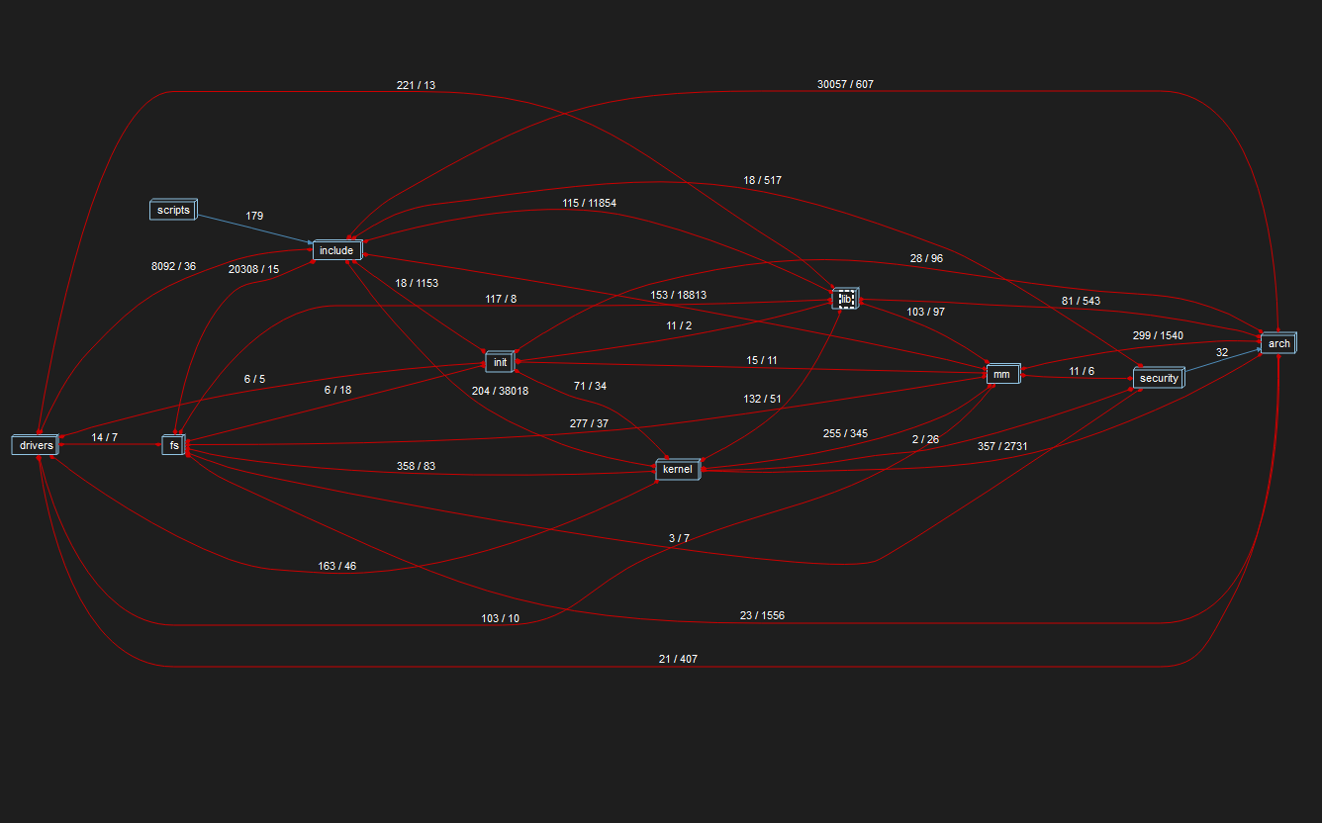

Slide 113
Analysis Spring Framework

Slide 114
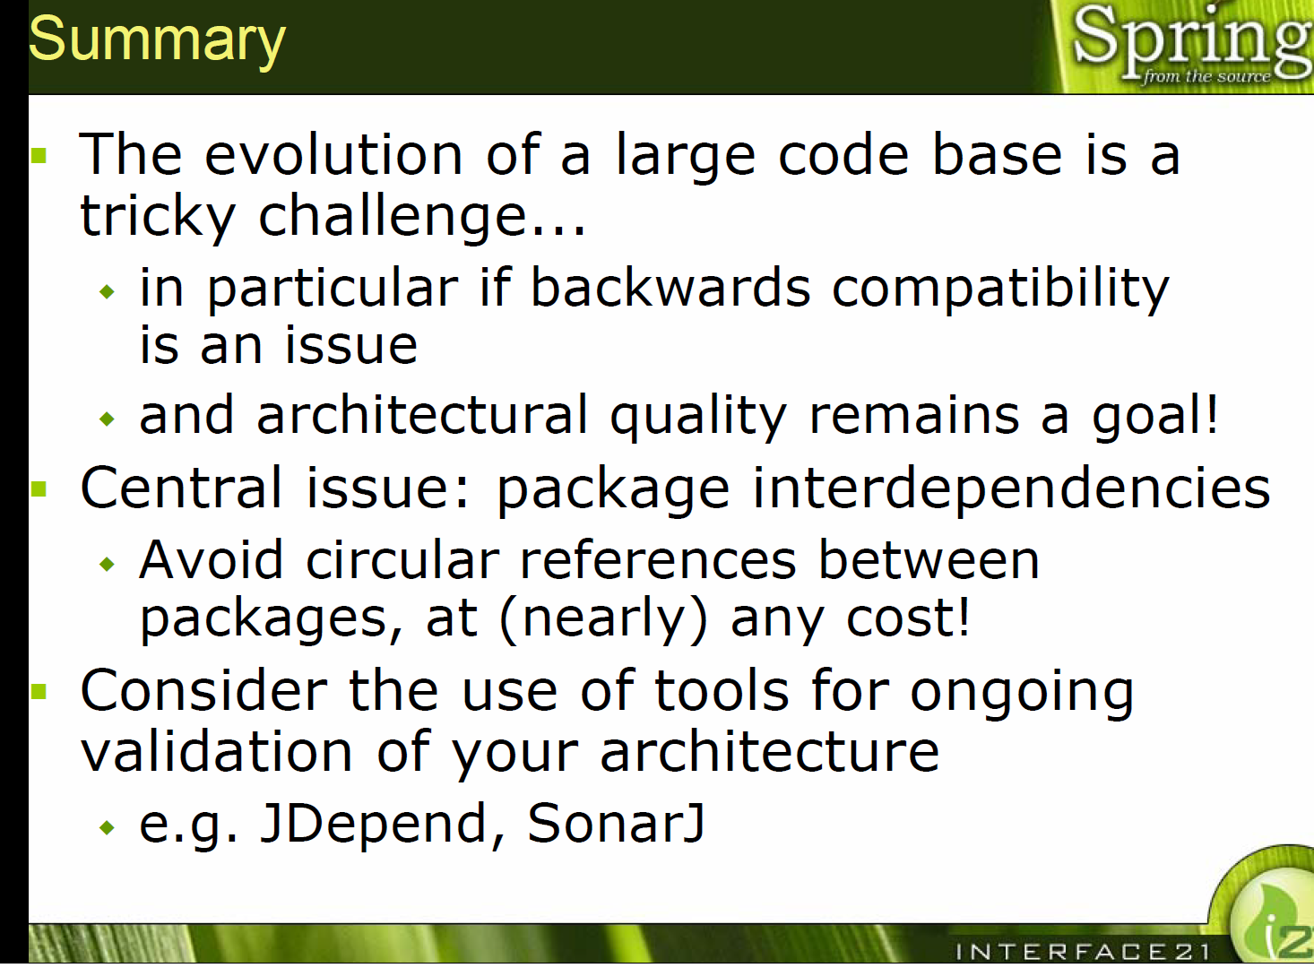
https://res.infoq.com/news/2007/06/large-code-bases/en/resources/code-organization_jho.pdf
https://www.infoq.com/presentations/code-organization-large-projects/

Slide 115
DsmSuite

Slide 116
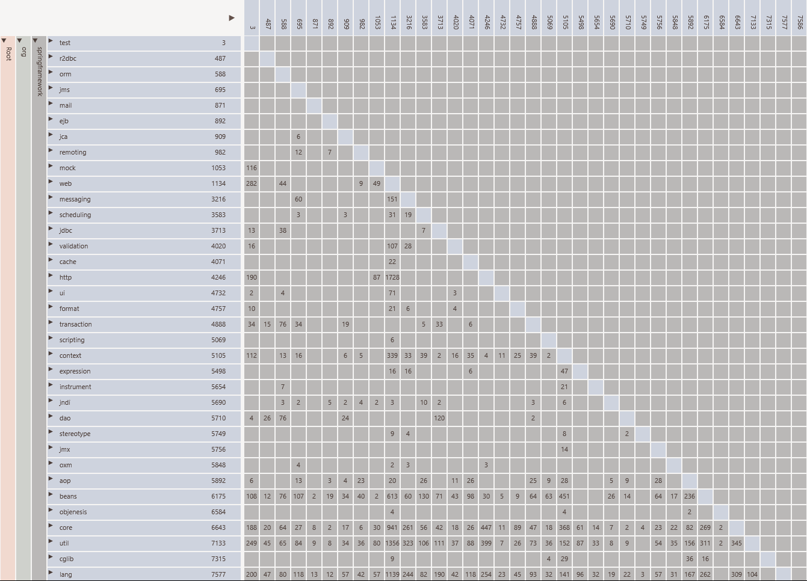

Slide 117
Structure101

Slide 118
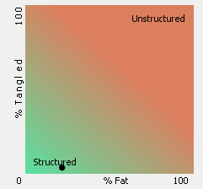
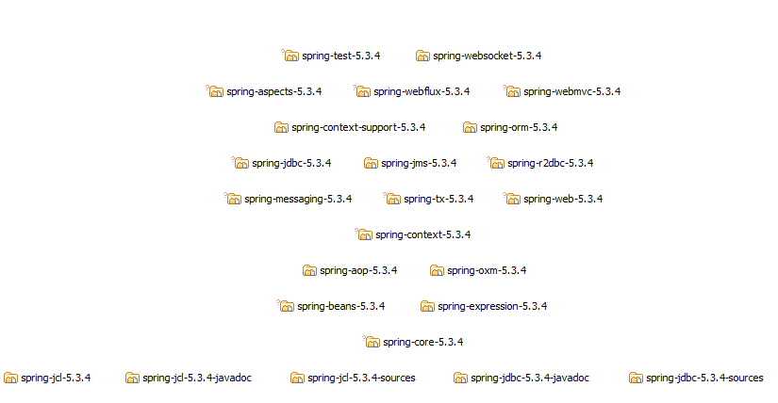

Slide 119
So ….

Slide 120
Average state

Slide 121
Visualiation can help

Slide 122
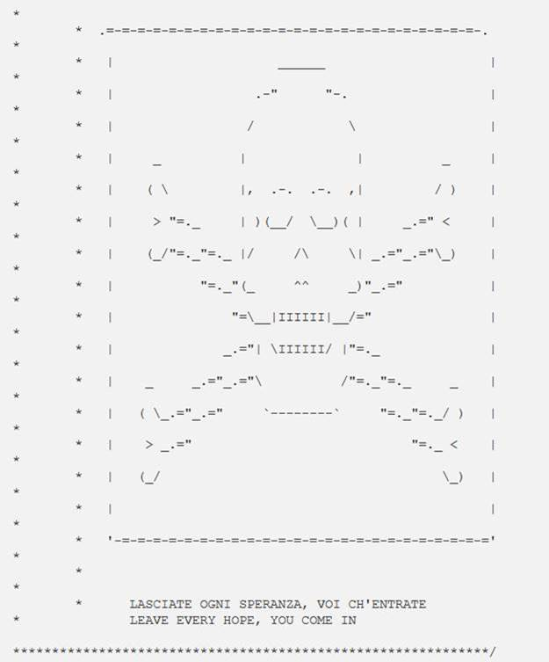

Slide 123
Clean code

Slide 124
Clean code
Try it
Was it useful
Provide feedback

Slide 125
Liked it ?

Slide 126


Slide 127
Questions ?

